Slide 1
Converting fractions to recurring decimals
Comparing and ordering fractions and decimals (positive and negative)

Slide 2
how to use Oak lessons

Slide 3
I can divide the numerator of a fraction by its denominator and know that this results in an equivalent recurring decimal.

Slide 4
A terminating decimal is one that has a finite number of digits after the decimal point.
Example
Example
Non example
Non example

Slide 5

A recurring decimal is one that has an infinite number of digits after the decimal point.
The recurring digits after the decimal point are represented using dots. A dot is placed above the first digit that recurs and the last digit that recurs.
Example
Example
Example

Slide 6

Converting fractions to recurring decimals
Recognising recurring decimals
Using a calculator

Slide 7
Recognising recurring decimals
Notation in mathematics is very important.
We use symbols and notation because:
they are easier to read and understand
they are concise and take up less space
they can be used to represent complex concepts
it allows mathematical ideas to be communicated more effectively than words

Slide 8
Recognising recurring decimals
We use special notation to show recurring decimals.
A recurring decimal is one that has an infinite number of digits after the decimal point. A dot is placed above the first digit that recurs and the last digit that recurs.
For example,
We don’t want to write
It is easier and more efficient to write

Slide 9



Recognising recurring decimals
Match the correctly notated recurring decimal with the decimal form.

Slide 10
Recognising recurring decimals
Now we know how a recurring decimal is represented in decimal form using the dot.
We also need to recognise recurring decimals when in fractional form.
So let’s do some short division to determine if the fraction gives a recurring decimal or not.

Slide 11
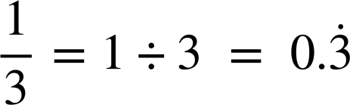
Recognising recurring decimals
Example
Is
the
fraction
equivalent to a recurring decimal?
.
0
3
3
3…
.
3 1
1
1
1
0
0
0
Yes it is a recurring decimal.

Slide 12
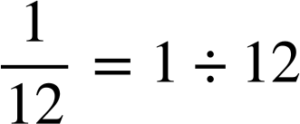
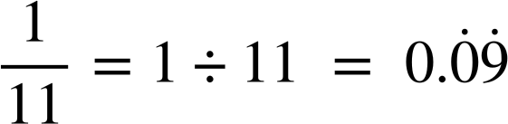
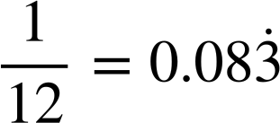
Recognising recurring decimals
Using short division, work out the decimal of the following fraction. Write your answer using correct notation.
Using short division, work out the decimal of the following fraction. Write your answer using correct notation.
.
.
0
3
0
0
9
9…
0
0
8
3…
11 1
.
.
12 1
1
10
4
4
1
10
1
10
0
0
0
0
0
0
0
0

Slide 13
Recognising recurring decimals
Using short division is a fantastic way to find the decimal form of a fraction whether it is terminating or recurring.
However, if we simply need to recognise if a fraction is equivalent to a recurring decimal, we can use knowledge of prime factors to identify if it is a terminating or recurring decimal.

Slide 14
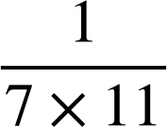
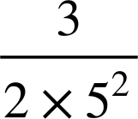
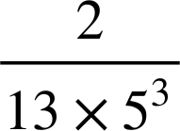
Recognising recurring decimals
A simplified fraction gives a terminating decimal when the denominator has prime factors of 2 and/or 5 only.
Therefore a simplified fraction gives a recurring decimal when the denominator has prime factors of any other prime.
Example
Example
Example
recurring decimal
terminating decimal
recurring decimal

Slide 15
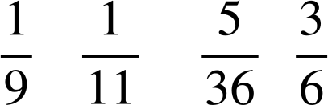

Recognising recurring decimals
Put a tick in the correct column to identify if the fraction is equivalent to a terminating decimal or recurring decimal.
Fraction | Equivalent to a recurring decimal | Equivalent to a terminating decimal

Slide 16
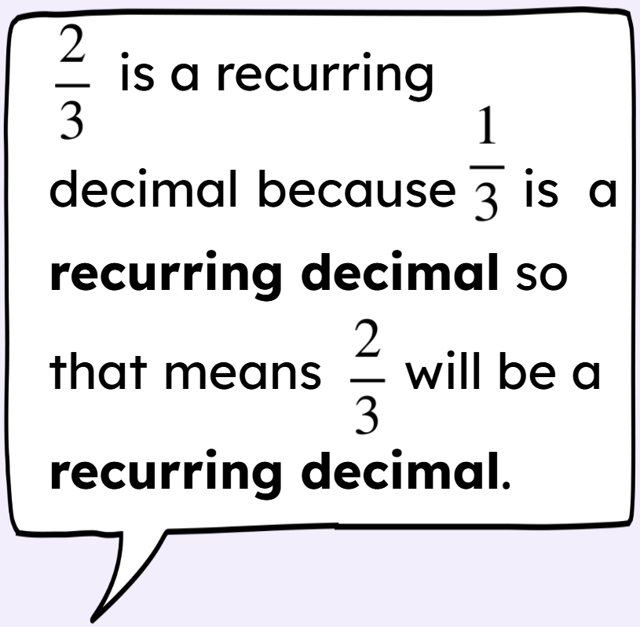
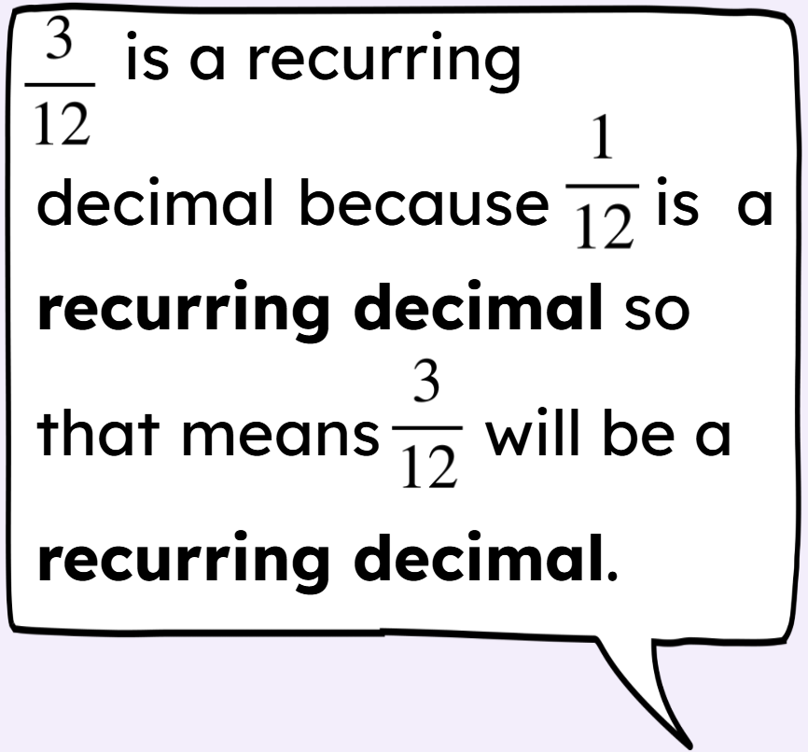
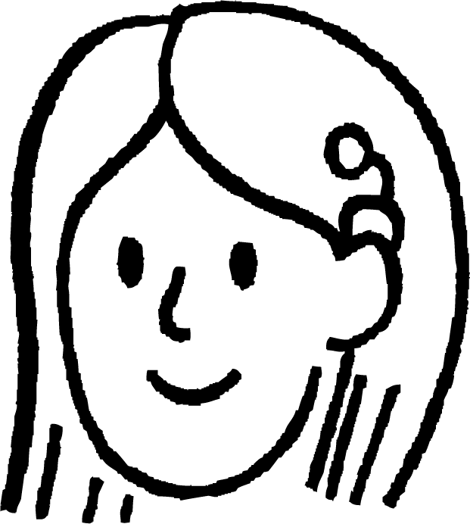
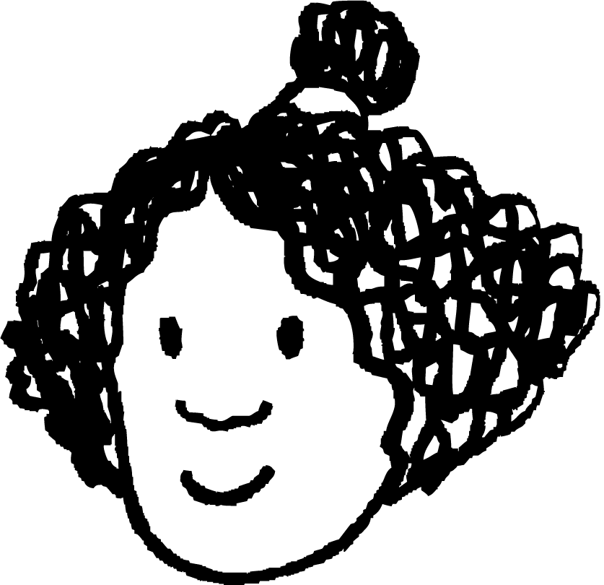
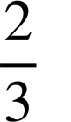
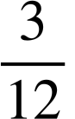

Recognising recurring decimals
Sofia says
Izzy says
Can you explain why one person is correct and the other is incorrect?
Sofia is correct and Izzy is incorrect. The fraction is in its simplest form.
Simplified is . This means is equivalent to a terminating decimal.

Slide 17
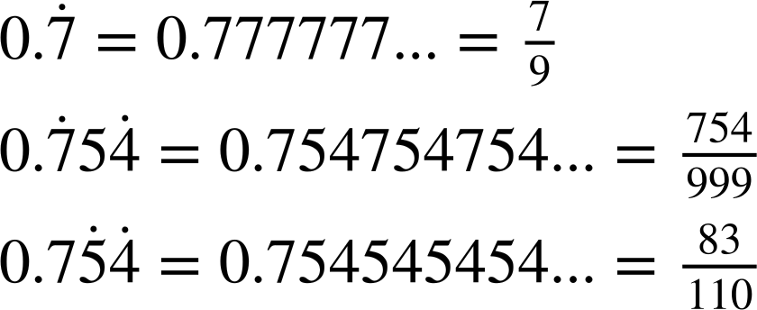
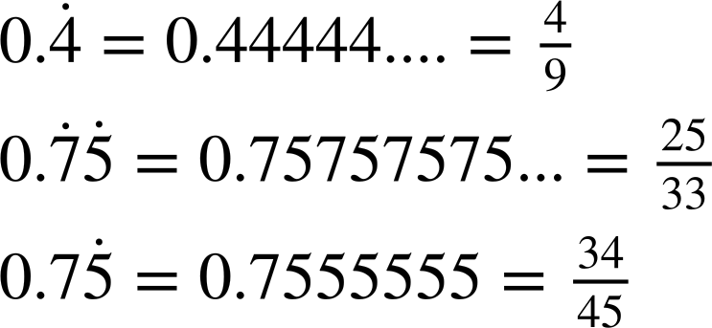
Recognising recurring decimals
Match the correctly notated recurring decimal with the decimal form.
…

Slide 18
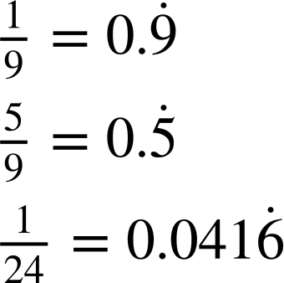
Recognising recurring decimals
2) Using short division, identify the recurring decimal of the following fractions:
a)
b)
c)

Slide 19
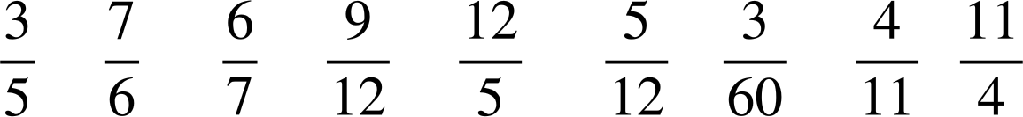
Recognising recurring decimals
3) Circle the fractions which are equivalent to a recurring decimal.

Slide 20
Recognising recurring decimals
Match the correctly notated recurring decimal with the decimal form.
…

Slide 21
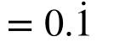
Recognising recurring decimals
2) Using short division, identify the recurring decimal of the following fractions:
a)
b)
c)

Slide 22
Recognising recurring decimals
3) Circle the fractions which are equivalent to a recurring decimal.

Slide 23
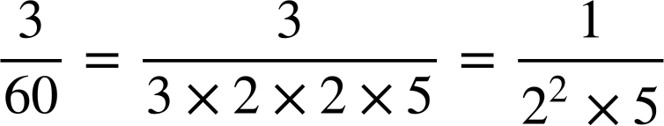
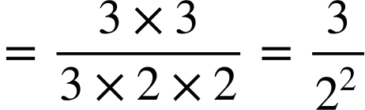
Recognising recurring decimals
3) Circle the fractions which are equivalent to a recurring decimal.
and are not simplified fractions.
When simplified their denominators only have prime factors of powers of 2 and/or 5 and so they will terminate.

Slide 24
Converting fractions to recurring decimals
Recognising recurring decimals
Using a calculator

Slide 25
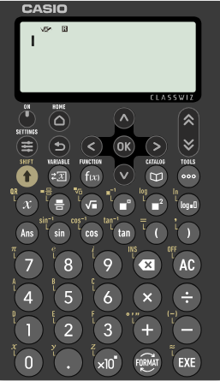

Using a calculator
Scientific calculators are fantastic tools.
The Casio fx 991 classwiz allows you to change the format of a number.
For example, let’s input
the
fraction
and
convert it into decimal form

Slide 26
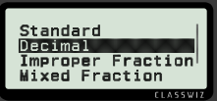
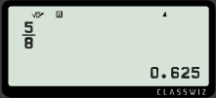
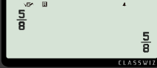


Using a calculator
Scientific calculators are fantastic tools.
The Casio fx 991 classwiz allows you to change the format of a number.
Press
To convert to a decimal

Slide 27

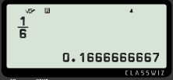
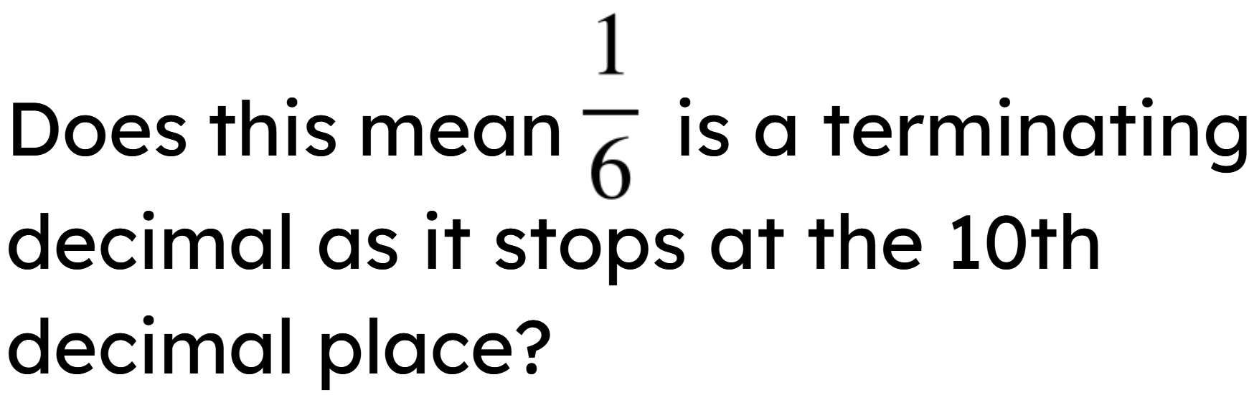
Using a calculator
Calculators are fantastic but it is important to remember they only have a limited number of digits.
For example,
Write all the digits displayed on your calculator screen when
converting
into a decimal.

Slide 28
Using a calculator
Calculators are fantastic but it is important to remember they only have a limited number of digits.
For example,
Write all the digits displayed on your calculator screen when converting into a decimal.
Because the calculator is limited to 12 digit display, the final digit is rounded. It is a recurring decimal.

Slide 29
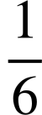
Using a calculator
Investigation
There is no button to press to show a recurring decimal as a fraction on the Casio Classwiz. You need to input the repeated digits a certain number of times for the equivalent fraction to appear.
What is the minimum number of decimal places you need to press to get 0.16666… displayed as
on you calculator?

Slide 30
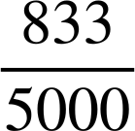
Using a calculator
Investigation
Decimal places | Input | Output
4 | 0.1666
6 | 0.166666 | 0.166666
10 | 0.1666666666 | 0.1666666666
12 | 0.166666666666 | 0.1666666667
18 | 0.166666666666666666

Slide 31
Using a calculator
Investigation
Decimal places | Input | Output
18 | 0.166666666666666666
We need to have 18 decimal places when a number is less than 1.

Slide 32
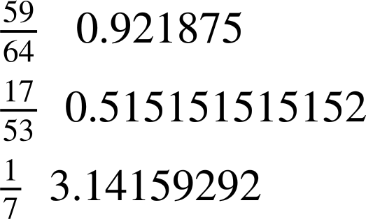
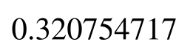
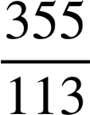
Using a calculator
Using a calculator, match the fraction to the equivalent decimal to the correct statement.
Terminating decimal
Non-terminating decimal

Slide 33
Using a calculator
2) Match the correctly notated recurring decimal with the fractional form.

Slide 34



Using a calculator
3) Write the following recurring decimals as a fraction.
a)
b)
c)

Slide 35
Using a calculator
Using a calculator, match the fraction to the equivalent decimal to the correct statement.
Terminating decimal
Non-terminating decimal

Slide 36
Using a calculator
2) Match the correctly notated recurring decimal with the fractional form.

Slide 37
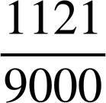
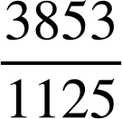
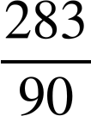
Using a calculator
3) Write the following recurring decimals as a fraction.
a)
b)
c)

Slide 38
Converting fractions to recurring decimals
A recurring decimal is one that has an infinite number of digits after the decimal point.
The recurring digits after the decimal point are represented using dots. A dot is placed above the first digit that recurs and the last digit that recurs.
Example
Example
We can identify recurring decimals using short division, prime factors or spotting a relationship with denominators.

Slide 39

© Oak National Academy 2023.
Produced in partnership with Mathematics in Education and Industry.
Licensed on the Open Government Licence v3.0, except where otherwise stated. See Oak terms and conditions.

